Slide 1

Housing Project

Slide 2
INTRODUCTION
Business Problem
A US-based housing company named Surprise Housing has decided to enter the Australian market. The company uses data analytics to purchase houses at a price below their actual values and flip them at a higher price.
The company is looking at prospective properties to buy houses to enter the market. You are required to build a model using Machine Learning in order to predict the actual value of the prospective properties and decide whether to invest in them or not. For this company wants to know:
• Which variables are important to predict the price of variable?
• How do these variables describe the price of the house?

Slide 3
Analytical Problem Framing
Mathematical/ Analytical Modelling of the Problem
Describe the mathematical, statistical and analytics modelling done during this project along with the proper justification.
Data Sources and their formats
A US-based housing company named Surprise Housing has decided to enter the Australian market. The company uses data analytics to purchase houses at a price below their actual values and flip them at a higher price. For the same purpose, the company has collected a data set from the sale of houses in Australia. The data is provided in the CSV file below.
The company is looking at prospective properties to buy houses to enter the market. You are required to build a model using Machine Learning in order to predict the actual value of the prospective properties and decide whether to invest in them or not. For this company wants to know:
What are the data sources, their origins, their formats and other details that you find necessary? They can be described here. Provide a proper data description. You can also add a snapshot of the data.

Slide 4
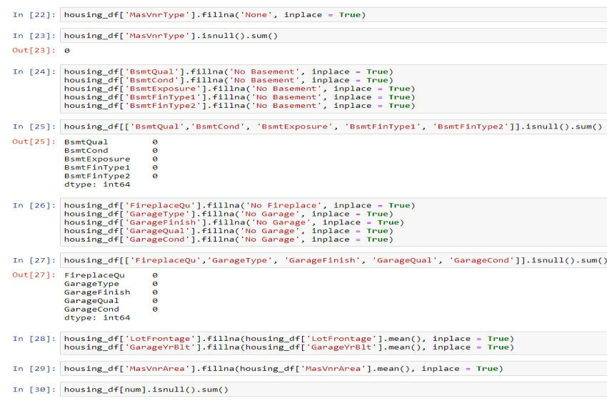
Data Preprocessing

Slide 5
Hardware and Software Requirements and Tools Used
Model Development and Evaluation
Problem solving methods
Approach followed during the course of predicting the house sales price Data given was imported as DataFrame. Next, the basic information like the datatypes, checking the count of non-null values in the data with info() function, then summary statistics of both numerical and categorical data which provides us the information about the count, frequency, unique, top values for the categorical data and mean, standard deviation, minimum, maximum, 25th percentile ,50th percentile, percentile (median), 75th percentile of the numerical data.
Checking null values, imputing the null values, dropping the
columns with null values almost close to the size to data, plots like countplot, barplot, regression plot, categorical plot were plotted to check the effectiveness of the input variable with the target variable and its behaviour.
Next, correlation matrix was plotted through which we could identify the how the input variable is correlated with the target variable and also, we see the multicollinearity which is even checked by seeing the variance inflation factor.
Next skewness was checked and removed with log and square transforming methods. Next outliers were identified.
Later the data was split into features (X) and target (y).
MinMaxScaler method was used for transforming and to reduce the dimensionality of the data PCA (principal component analysis) was used.
Model Building – 5 models used for training along with cross
validation and the best model was tuned with hyperparameters. And the two models were deployed one with tuned one and other without and comparison was done with predicted and original with plots.
Lastly, the price was predicted for the test data provided which was cleaned before predicting the sales price of the house

Slide 6
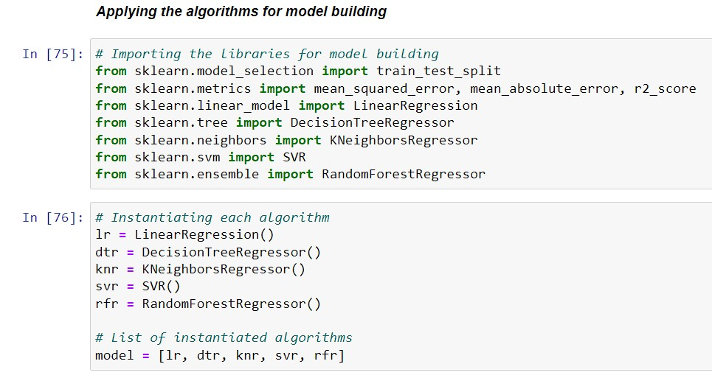
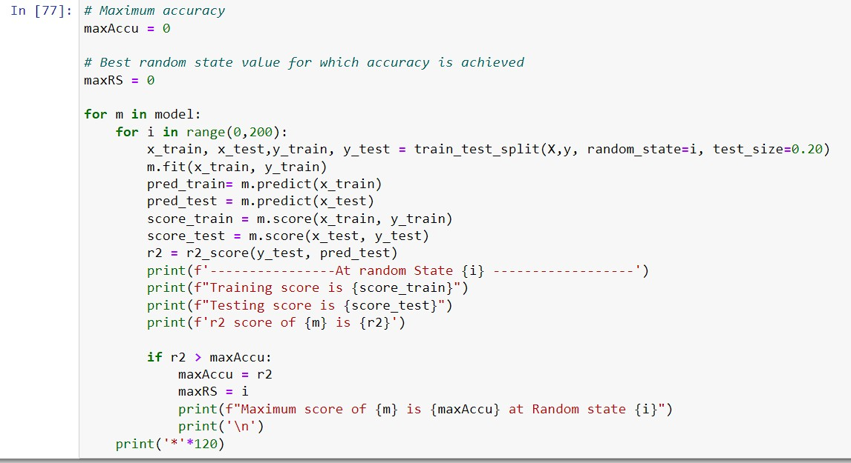
Algorithms used
Maximum score of RandomForestRegressor() 0.8134658396095735 at Random state 107
• Training score is 0.9533843304262911
• Testing score is 0.8134658396095735
r2 score of RandomForestRegressor() is 0.8134658396095735

Slide 7
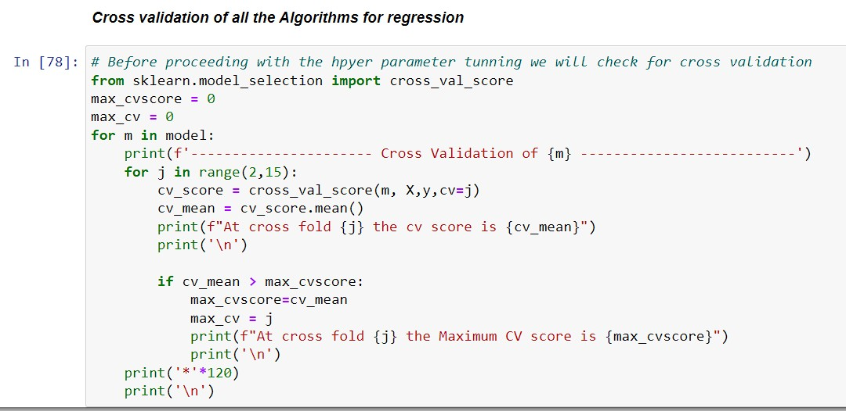
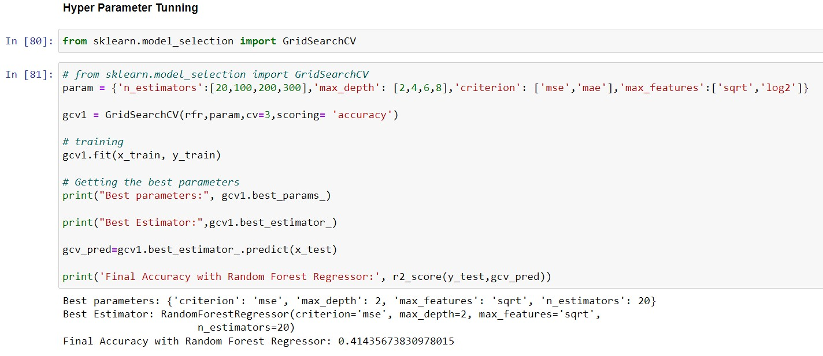
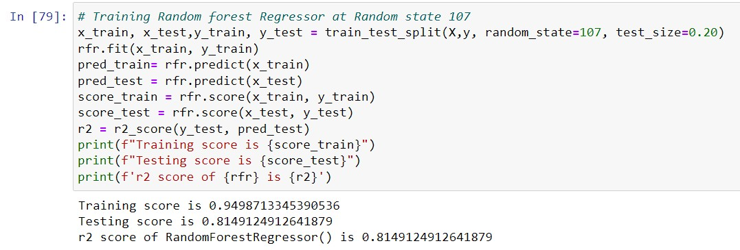
For Random forest at cross fold 3 the Maximum CV score is 0.7180619511702199
Key Metrics consideration
for success
in solving problem under

Slide 8
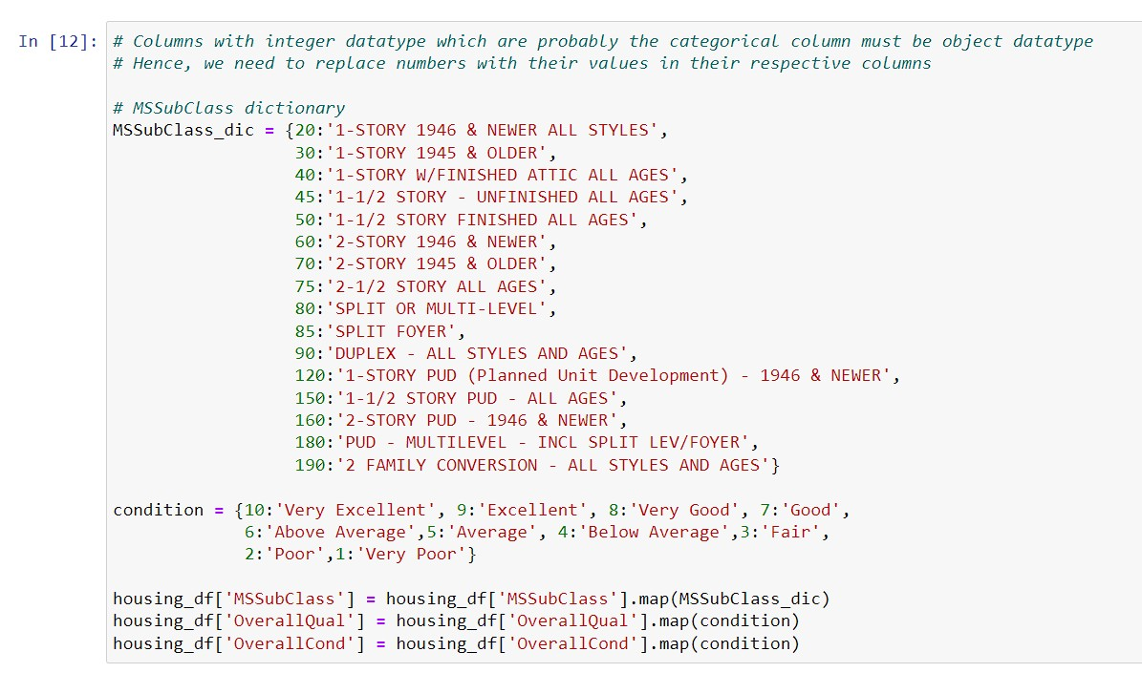
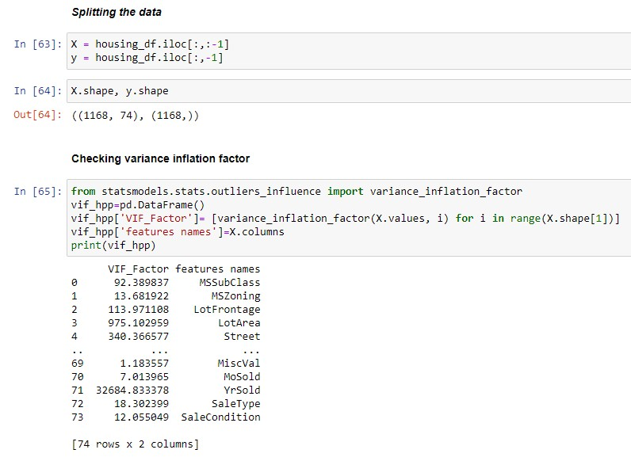
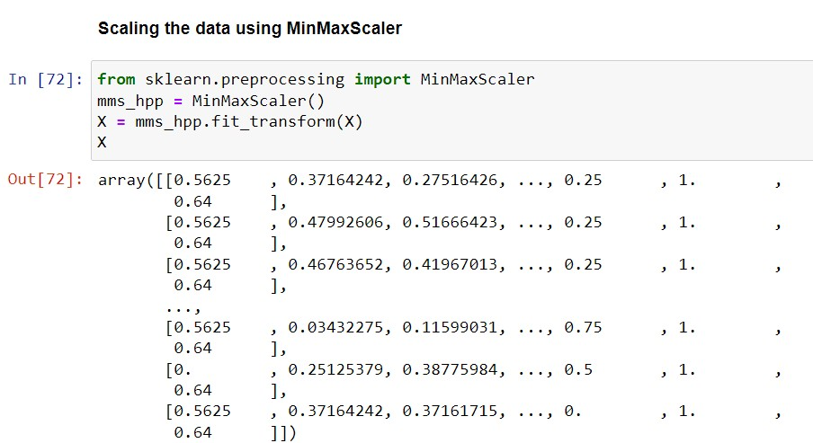
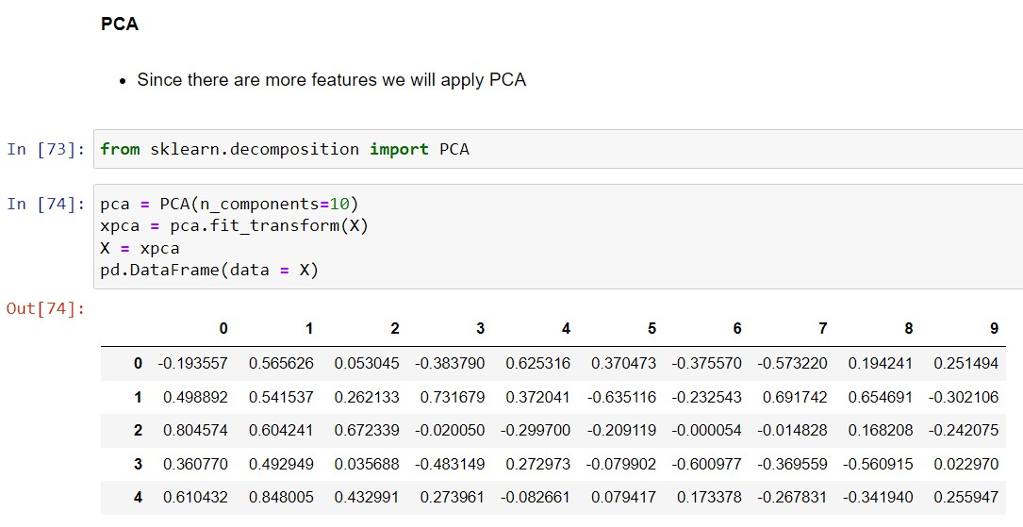
Scaling is used to transform the data to normal distribution.

Slide 9
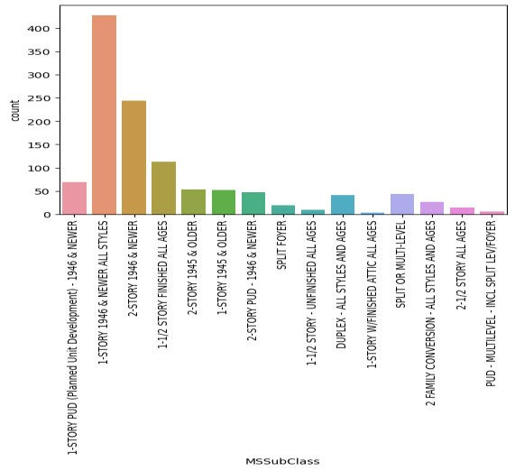
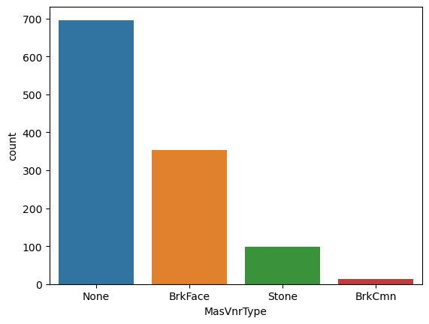
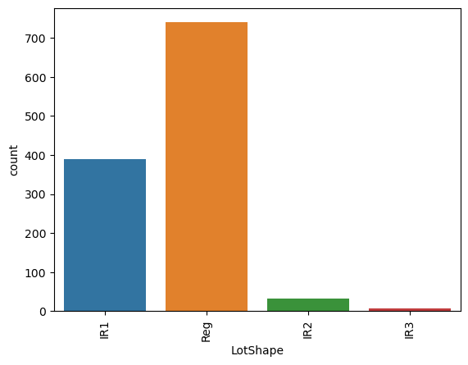
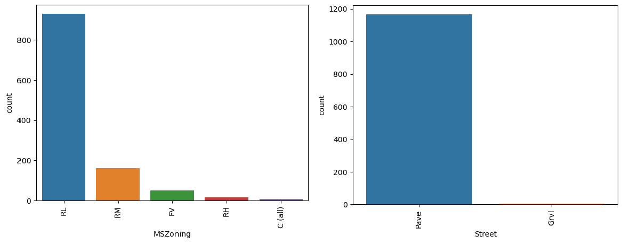
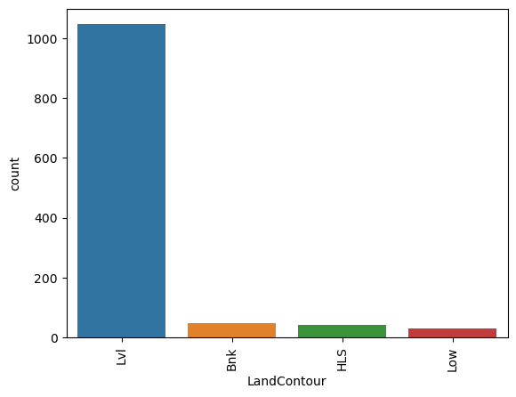
Visualizations

Slide 10
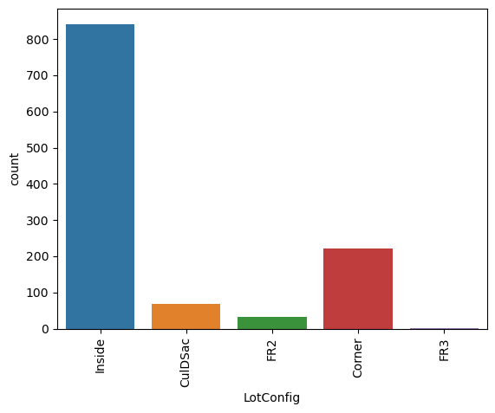
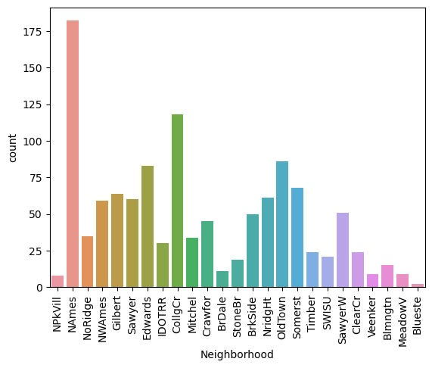
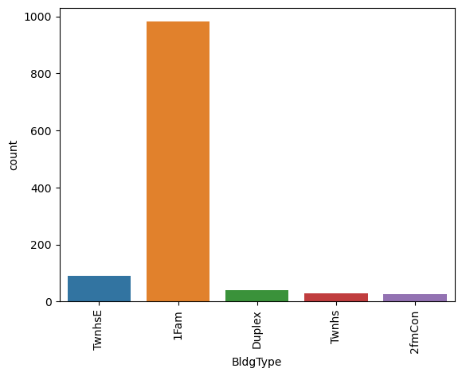
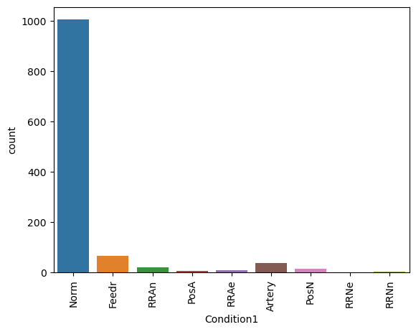
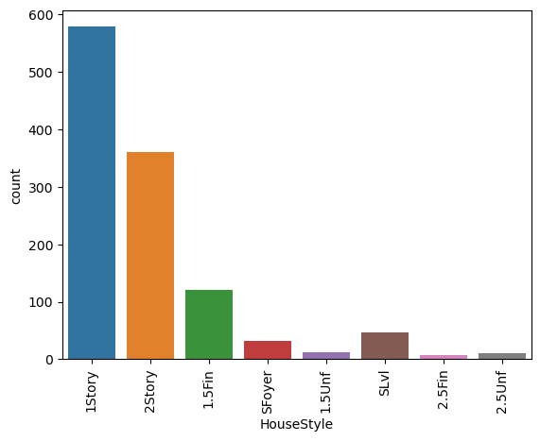
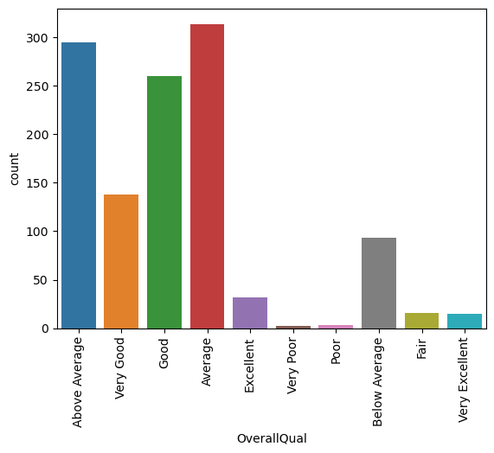

Slide 11
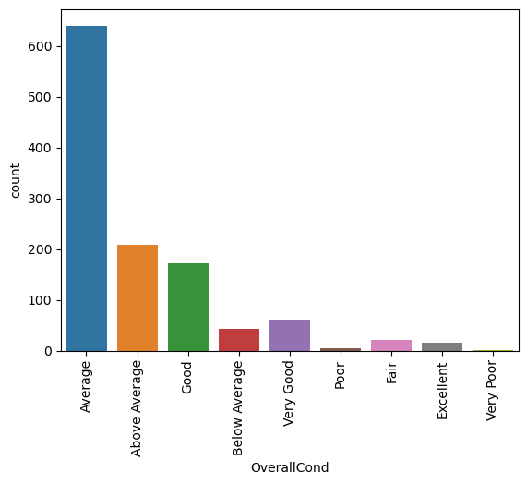
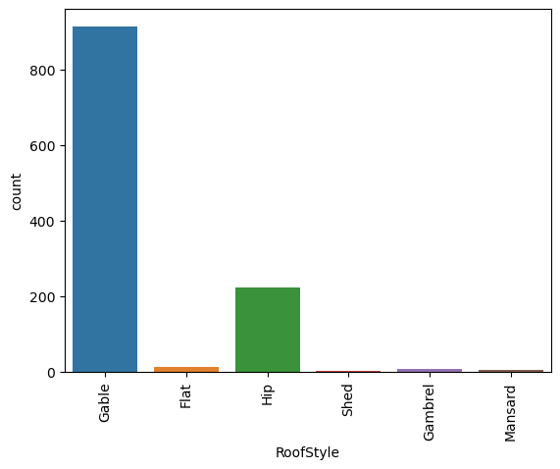
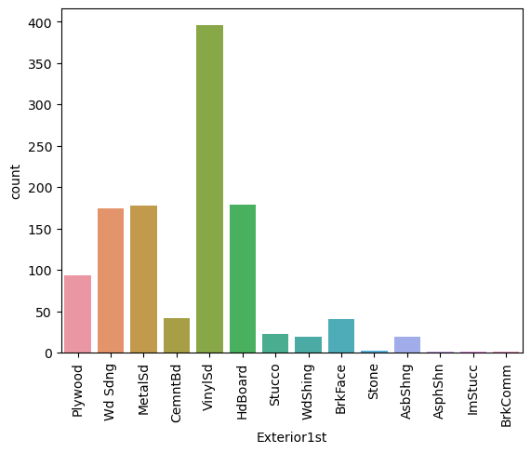
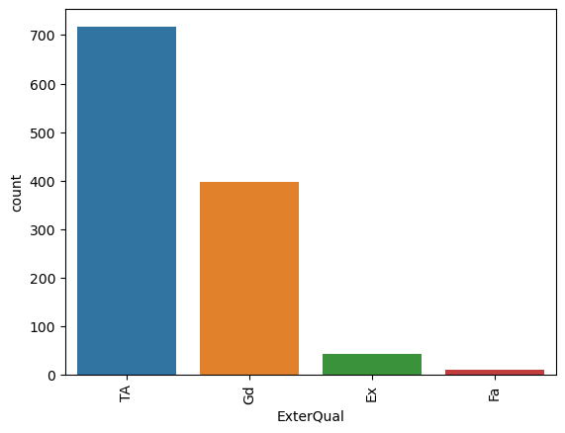
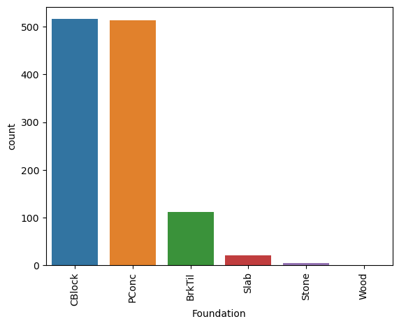
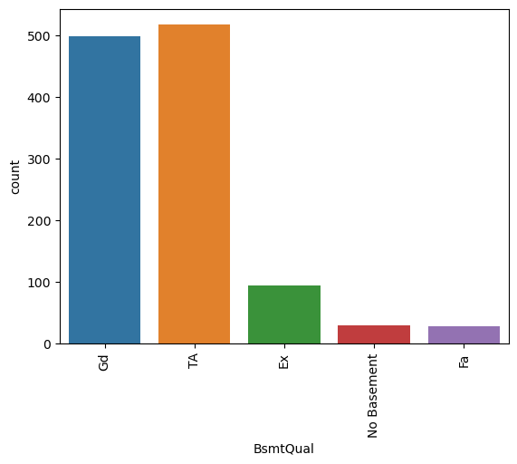
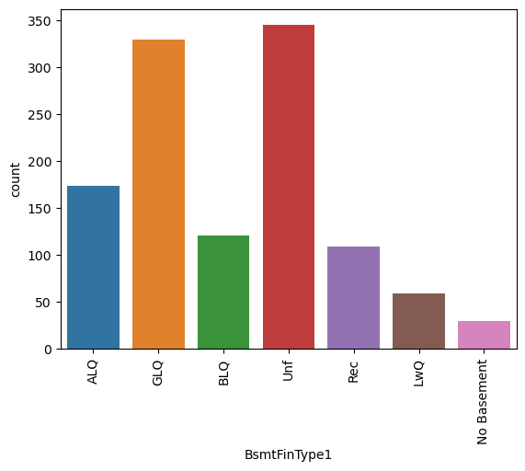
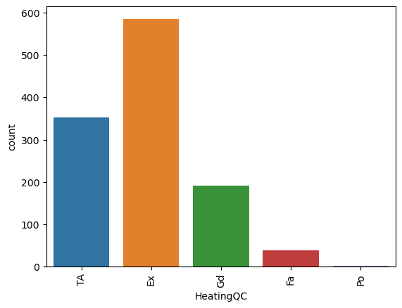

Slide 12
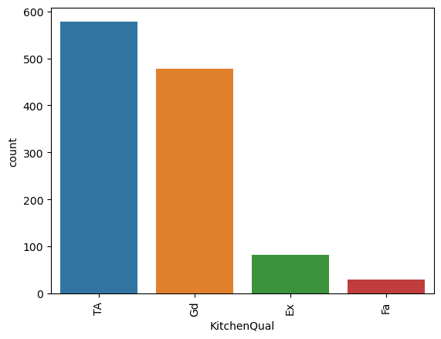
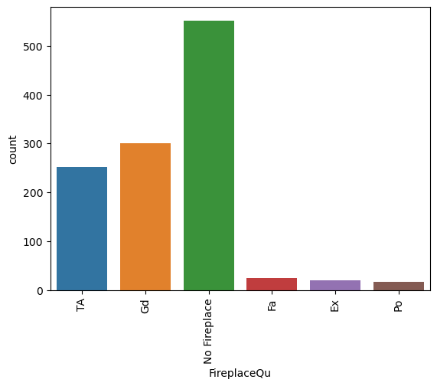
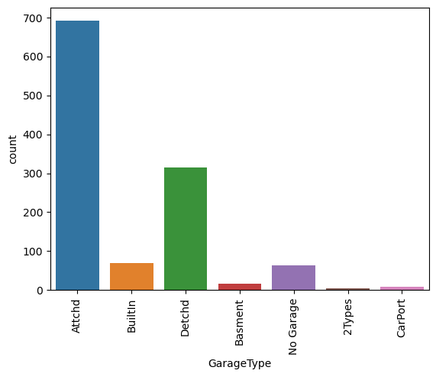
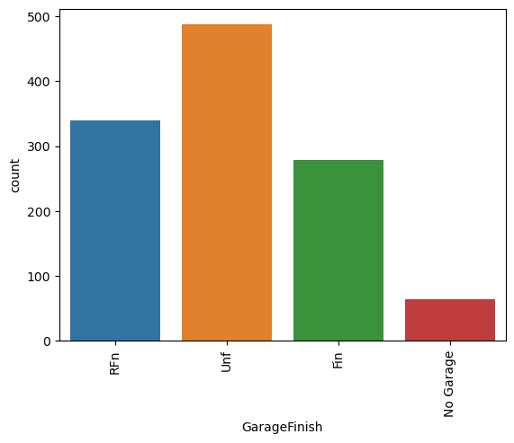
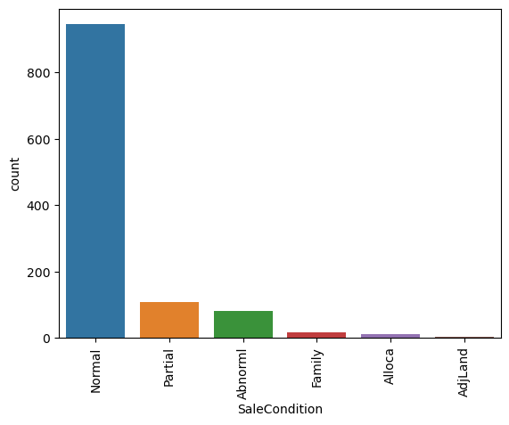
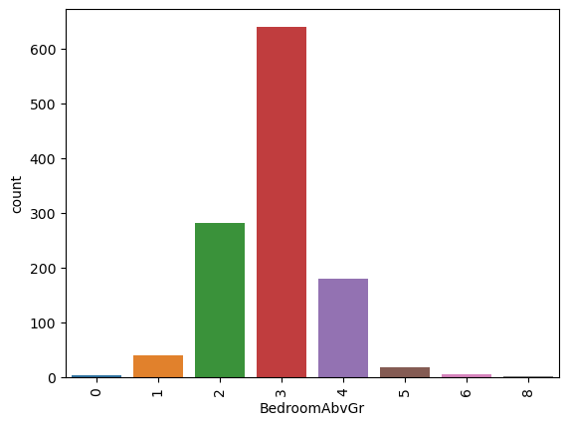
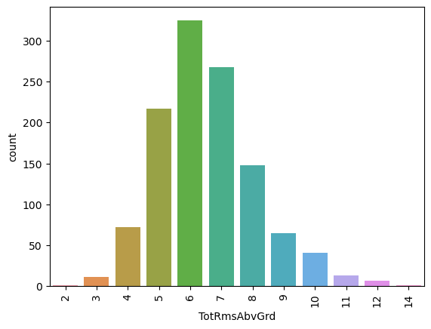
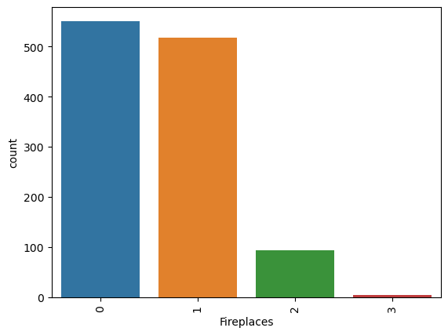

Slide 13
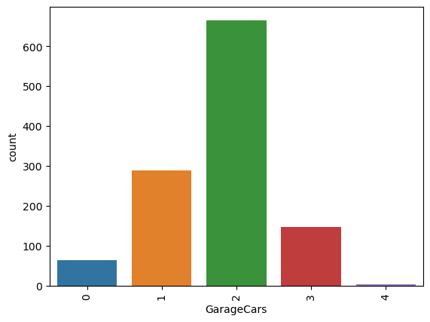
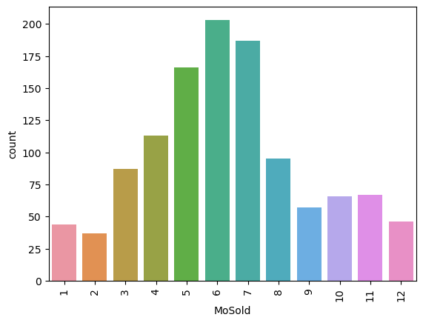
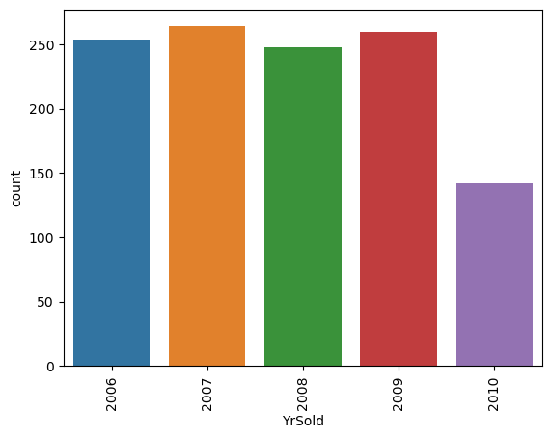
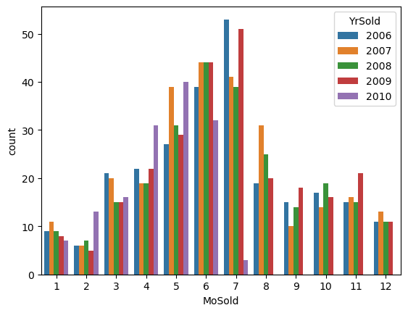
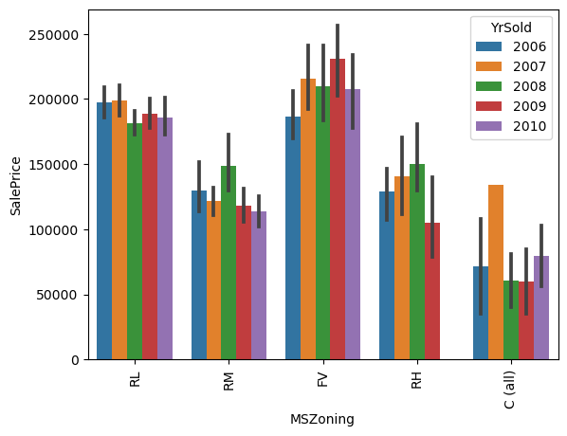
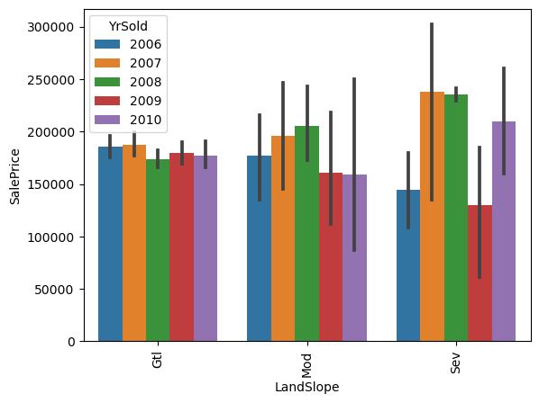
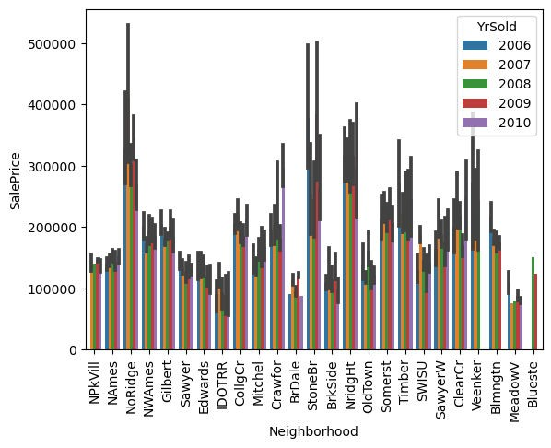
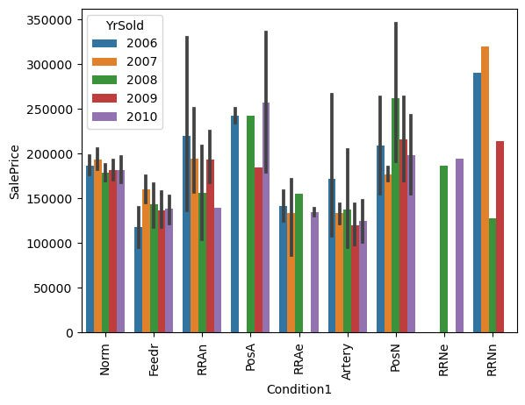

Slide 14
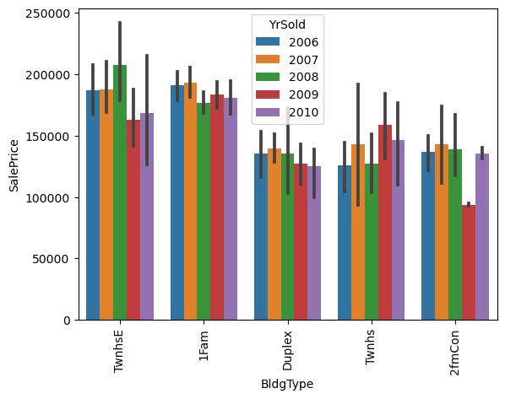
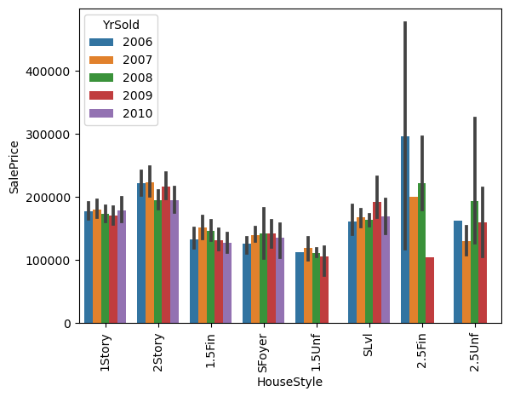
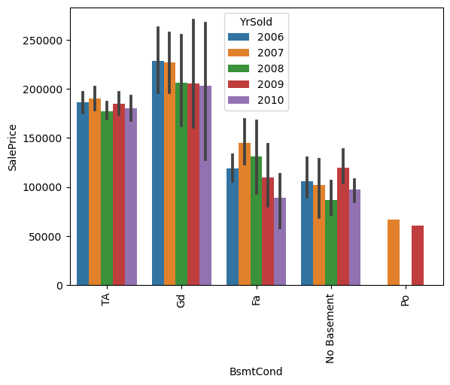
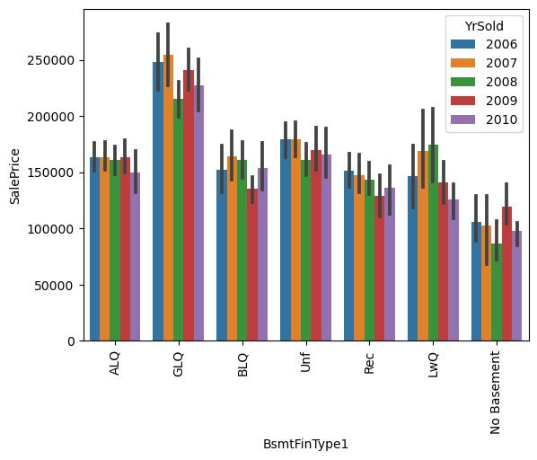
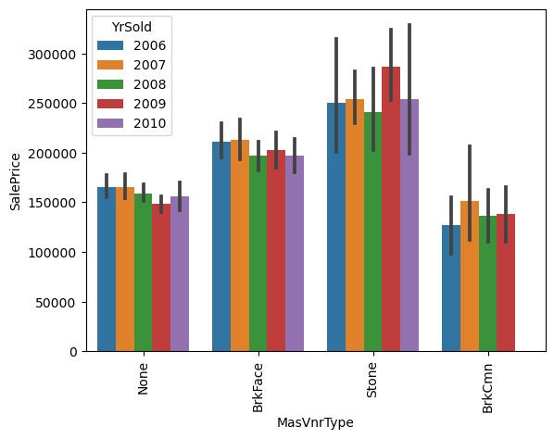




Slide 15









Slide 16









Slide 17







Slide 18


Slide 19





Interpretation of the Results

Slide 20



Slide 21
CONCLUSION
Count plot provided the count of each categorical value present in column which provided how the data is distributed.
These plots gave an idea how to replace the NaN values present in categorical features.
Bar plots were plotted for all categorical variables with respect to the target variable (sales price) for all the years and cone can see that neighbourhood, Excellent kitchen quality, building type, house style with Two and one-half story: 2nd level finished, good basement condition etc play important role in the sales price house.
They later with the help of bar plot maximum sales and average sale each year and for every year sales every month.
The Maximum sales happened to be in 2007.
Next, a categorical plot was plotted for house style building type for sales price, the sales most commonly occurred for building type one family.
After training, the random forest algorithm gave better results with accuracy of 81.34% for model without beentuned using hyperparameter tunning. With tunned model the final accuracy id 41.43%.
The accuracy was less because the outliers were present in the data. The data was getting reduced to half if we remove outliers.
Later after pickling the predicted and original sales price was
plotted to check the comparison of both the models with and without tunning. The model without tunning gave better results as one can see through the error plot. The kde plot gave us the range how the data is getting predicted, the tunned model spread was lower with high density and whereas the one without tunning has good spread for predicted the sales price.
Lastly, the sales price was predicted for the test data which was provided after applying data pre-processing, feature engineering as done for the training data.

Slide 22
Learning Outcomes
What I learned here is how one has to extensively look at the data and see its behaviour with help of EDA. This will help us identify the important features for predicting the target.
Scope for Future Work
The data can be more explored for feature engineering with more literature review.
The Outliers present can be treated in a more efficient way to improve the accuracy of the model.
We can apply more algorithms along with hyper tunning parameters to improve the accuracy.

